Slide 1
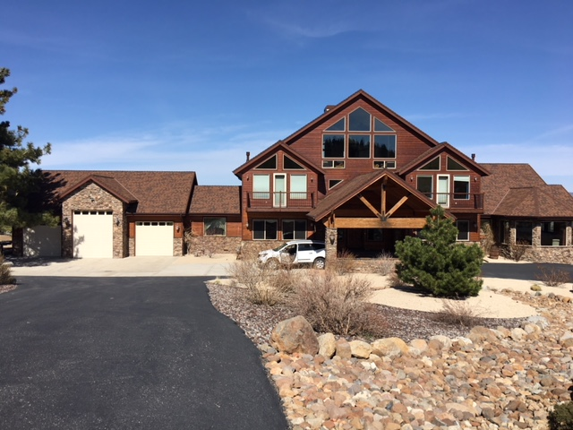
Special Use Permit WSUP18-0004
Washoe County Board of Adjustment
May 3, 2018
Tru Reno B&B

Slide 2
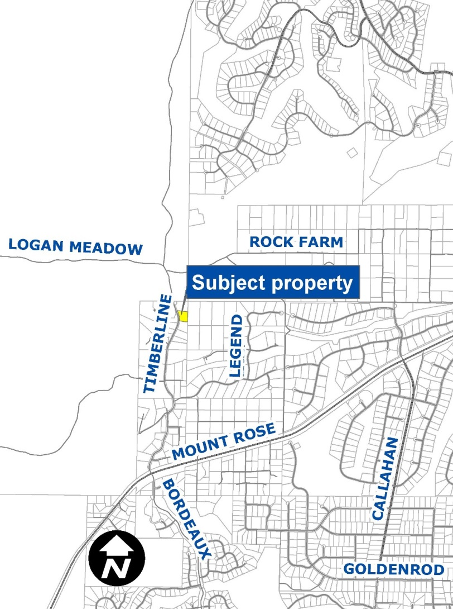
Vicinity Map
15030 N. Timberline Dr. (APN 049-871-10)
North of Mt. Rose Highway
Low Density Suburban
1.5-acres

Slide 3
Overview of Request
Bed & breakfast inn with 5 guest rooms
Max. 10 guests allowed
Uses existing 6 BR, 7 BA residence (Approx. 10,000 sq. ft. on 3 levels; 2 garages
Proposes cooking and healthy eating classes and fitness activities

Slide 4
Code Standards for B&Bs
On-site operator
Max. 7-night stay
No adverse visual impact from parking
Compliance with all codes
Business license
Room taxes paid by operator

Slide 5
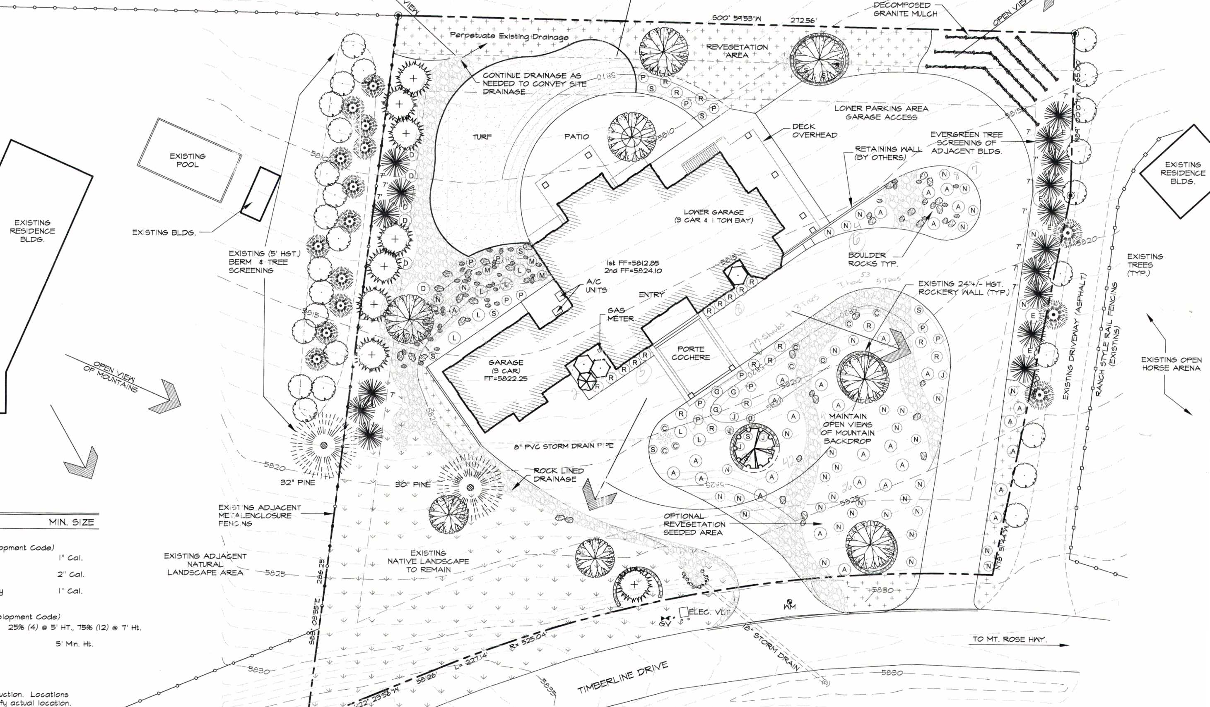
Site Plan

Slide 6
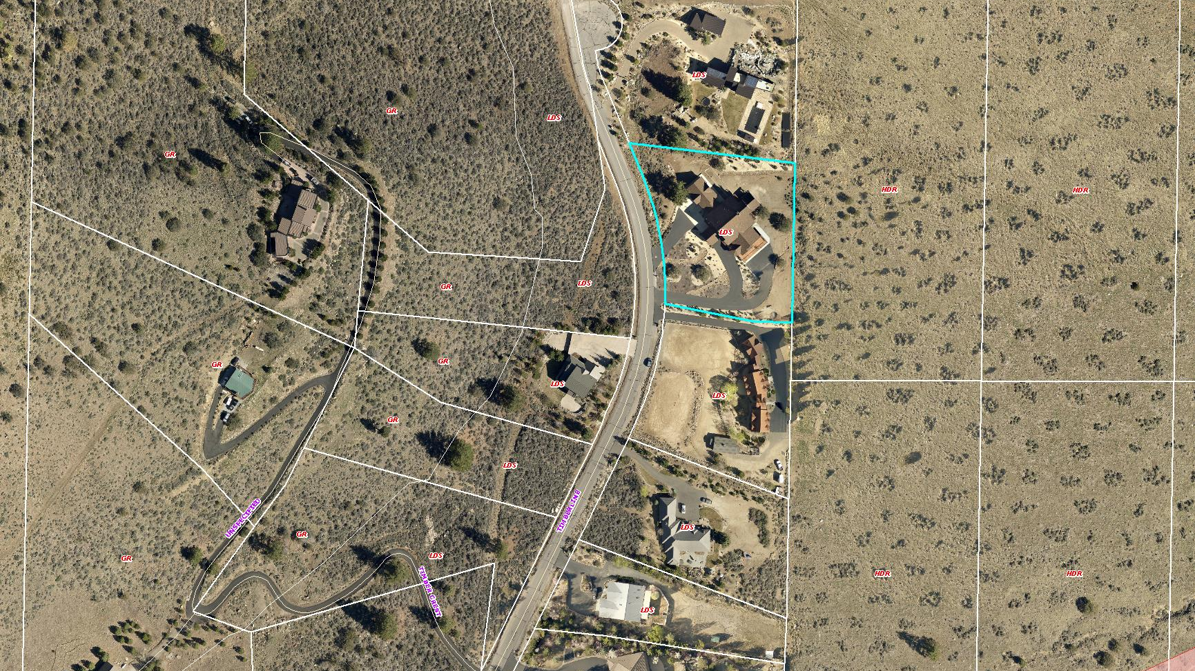
Aerial View
TIMBERLINE DR
SUBJECT
PARCEL
FEDERAL
PROPERTY

Slide 7
Site Photos

Slide 8
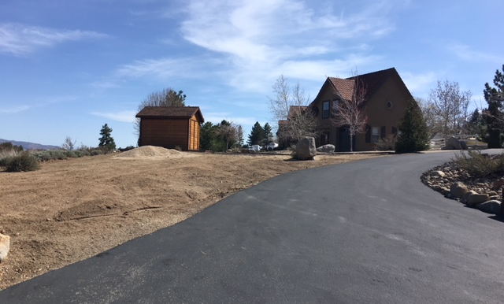
Site Photos

Slide 9
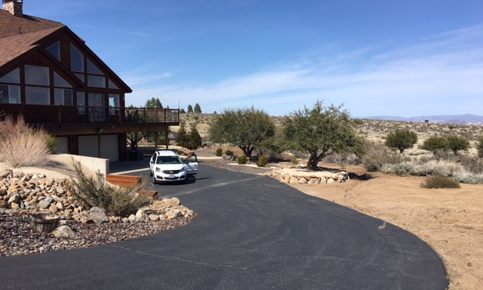
Site Photos

Slide 10
Project Impacts
Traffic
Below threshold requiring traffic impact report
Expected to generate 8.92 trips/room/day
Overall: Additional 44.6 trips/day and 3.7 p.m. peak hour trips
Noise
Check-in 4-8 p.m. Conditions limit times for outdoor activities and deliveries

Slide 11
Citizen Advisory Board (CAB)
April 5: South Truckee Meadows/Washoe Valley CAB
Voted 3-1 to forward comments
Discussion on:
2009 special use permit (expired)
Roadway capacity of N. Timberline Drive
Commercial use in residential area

Slide 12
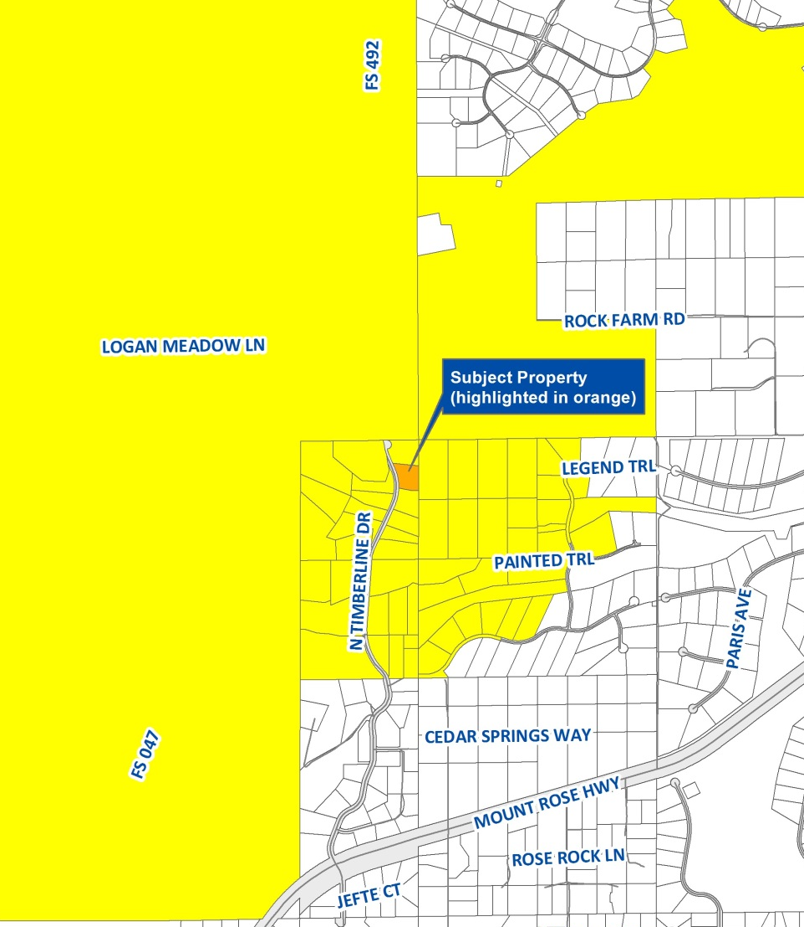
Public Notice
Notice provided to 37 owners of 60 parcels within 1,750-ft.
Several comments received this week in opposition to project

Slide 13
Reviewing Agencies
Washoe County Community Services Department
Planning & Building
Engineering & Capital Projects
Utilities
Regional Parks & Open Space
Truckee Meadows Fire Protection District
Washoe County Health District
Nevada Division of Environmental Protection
Regional Transportation Commission
Washoe-Storey Conservation District
Truckee Meadows Water Authority

Slide 14
Recommended Conditions
Updated parking/landscaping, including screening
No events
Outdoor activities limited to 7 a.m.-10 p.m.
Change of occupancy permit may be required
Fire sprinkler, alarm and other life/safety standards
State permit for commercial on-site sewage disposal
Health District standards for food establishments
Other operational conditions

Slide 15
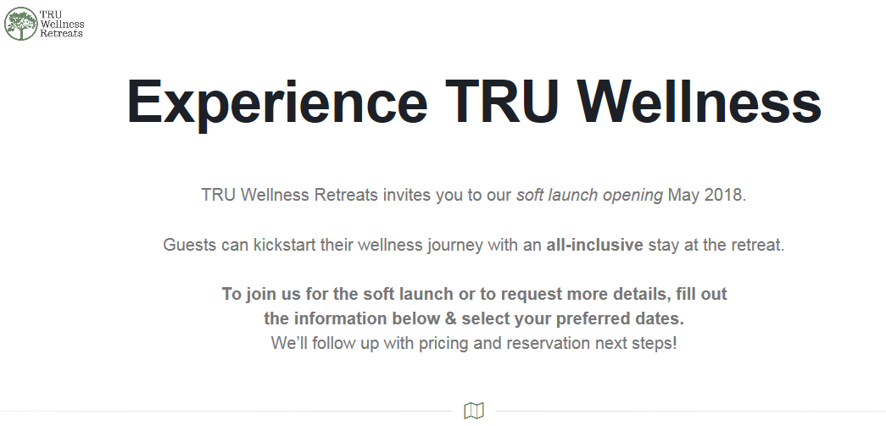
Website Excerpts

Slide 16
Website Excerpts

Slide 17
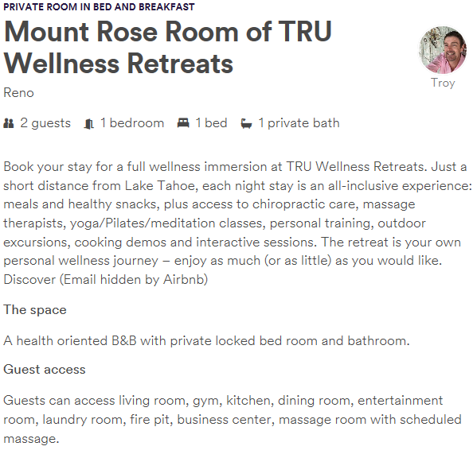
Website Excerpts

Slide 18
Additional Conditions
1(e)(xx)
On-site activities and services offered by the facility are limited to overnight guests of the bed and breakfast. No services or activities shall be offered to anyone other than paying guests of the inn.

Slide 19
Additional Conditions
1(e)(xxi)
The applicant shall cease and not engage in any unlicensed business activity associated with the bed and breakfast request until all required permits and/or licenses are obtained. This includes, but is not limited to, rental of the on-site accommodations.

Slide 20
Required Findings
Special Use Permit
Consistency
Improvements
Site suitability
Not detrimental
Forest Area Plan
Community character
Air quality
Bed and Breakfast
Traffic
Commercial nature
Dwelling exists
Private controls
Noise levels
Hours of operation

Slide 21
Possible Motion
I move that, after giving reasoned consideration to the information contained in the staff report and information received during the public hearing, the Washoe County Board of Adjustment approve with conditions Special Use Permit Case Number WSUP18-0004 for Troy Underwood, having made all five findings in accordance with WCC Section 110.810.30, the six findings in accordance with WCC Section 110.320.20, and the two findings in accordance with the Forest Area Plan. This includes the two new conditions presented today.

